Slide 1


Plan of Action
November 19, 2020

Slide 2






Meet the Crisis Crusaders Team
Non-profit consulting organization based in New York, NY
Specializes in crisis management in response
20 total team members
$10M annual operating budget
MAHEEN
Data Analyst & Software Developer
TABASSUM
Information
Assurance
Analyst
STEPH
Project
Manager
ERIN
Communications Specialist
PATRICK
Head
Consultant
Notes:
Crisis Crusaders is a nonprofit consulting organization based in the United States that specializes in crisis management and response, and supports NGOs around the world. We have 20 total members in our organization, 5 of whom have been mobilized to respond to the current crisis that you will hear more about in the next slide. Our team and our roles have been outlined here: Maheen is our data analyst and software developer, Tabassum is an Information Assurance Analyst, Steph is our Project Manager, Patrick is the Head Consultant, and I am serving as the Communications Specialist for this project. You will hear more from each of them as the presentation continues.

Slide 3
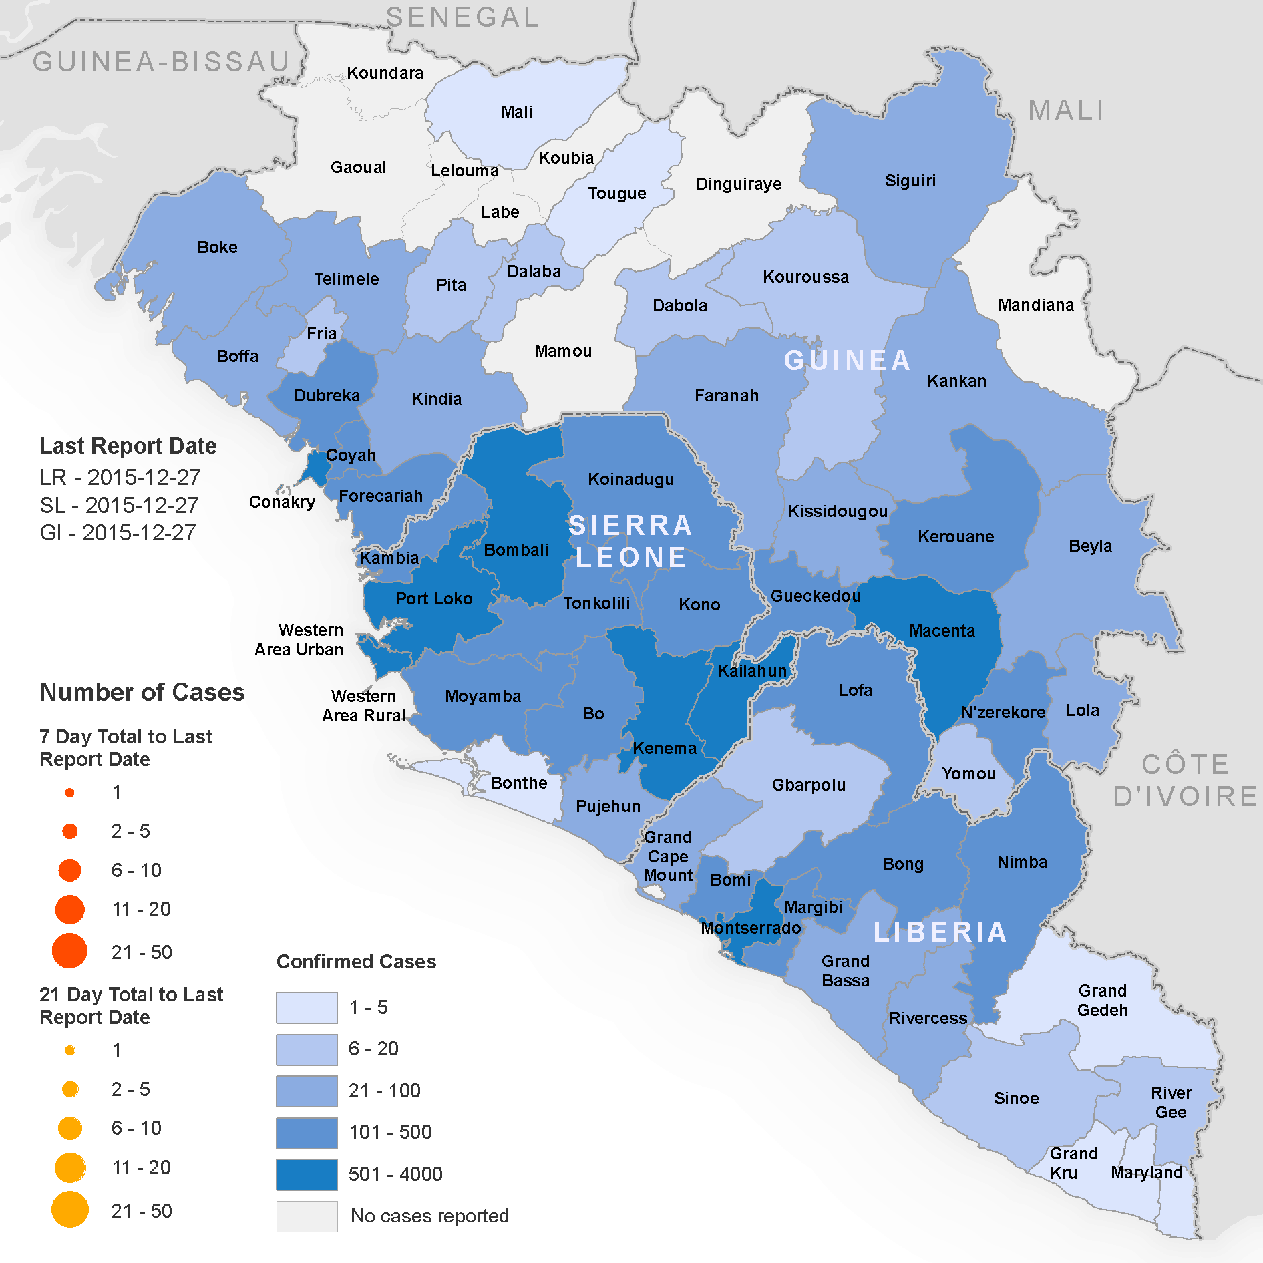
The Crisis and The Ask
The SMT
Charity Health Network (CHN)
Healthcare organization based in Sierra Leone
The Challenge
Ebola outbreak (scaling-up phase)
CHN’s current data storage and sharing methods lack security and efficiency
The Ask
Our Solution
We are here to present our research and our recommendation and to seek your approval to move forward.
Notes:
To provide some context, you all are the Senior Management Team for Charity Health Network, a healthcare organization in Sierra Leone that is currently experiencing a severe Ebola outbreak. Charity Health Network’s current methods of storing and sharing data lack the security and efficiency required to manage the crisis, and so we have been asked by your Head of Operations to assist in the scaling-up phase by proposing a technology solution that can enhance your organization’s ability to mitigate the Ebola crisis. We’ve done our research, we have a recommendation, and we are here to seek your approval to move forward with our plan.

Slide 4
Key Assumptions
Strong partnerships with Charity Health Network, other NGOs and health partners in Sierra Leone
CHN requires increased speed and security for data storage and sharing; we do not have time to start from scratch
National Electronics Bill of 2020 is the key driver of our data security features
1
2
3
Assumptions->may be approaches/change anything that says “we will”
Assume that we will not have the time or availability to create an app from scratch

Slide 5
Research and Recommendation
Cloud hosting
Software Development
Amazon AWS
Most experienced vendor
Cheaper with storage only
Data stored in Cape Town, Africa
Expensive additional services
In-house + 3rd party
Easy communication between groups
Not as costly as in-house
Ability to customize
Could take longer than 3rd party
Microsoft Azure
Expensive with storage only
Less experienced than AWS
In-house
Very costly
Time consuming
In-house
More expensive to hire full-time employees
Much longer timeline
3rd-party
Costlier
Potential security risks
Inability to customize
Our recommendation is to use a cloud hosting service and a combination of 3rd-party acquisition and in-house customization to develop an app that can process the data.
Add in line at top about research sentence at the beginning
Too busy, just add in icons? Put the four that we say no to on one side, two that say yes, on the other side.
Number the six and highlight red and green for pros/cons on all of them then draw a box around the ones recommended
“Third party app (TBD) will provide the app, we will provide the data science analytics for in-house” -> add this to the In-house+3rd party pros
Ideas for slide design: https://www.google.com/search?q=option+comparison+pros+cons&tbm=isch&ved=2ahUKEwjt1dK574DtAhVSbqwKHY1cC5YQ2-cCegQIABAA&oq=option+comparison+pros+cons&gs_lcp=CgNpbWcQAzoECCMQJzoCCAA6BAgAEB46BAgAEBhQ8FhYjGtg7mtoA3AAeACAAUqIAZAGkgECMTKYAQCgAQGqAQtnd3Mtd2l6LWltZ8ABAQ&sclient=img&ei=HTGvX63TL9LcsQWNua2wCQ&bih=735&biw=863&rlz=1C5CHFA_enUS918US918#imgrc=Kr8Xx6kfBlSTMM

Slide 6






Solution: CrisisCare
Build an app, CrisisCare, to help store Ebola data
Transfer data from spreadsheets to the cloud
CHN Health Centers
CrisisCare Mobile App
AWS Server
Easily share sensitive data with partner NGOs
Connected to the cloud for quick and secure data transfer
Track Ebola cases and stop new outbreaks
Share data with other NGOs
Track Ebola cases
Simplifies, standardizes, and secures Ebola data tracking
Stop Ebola
Notes:
Our solution is the build an app called CrisisCare to store ebola data. CHN’s current methods of storing data in spreadsheets will be improved by storing to the cloud. As Tabbassum mentioned, we will be using AWS to easily share sensitive data with other partner NGOs, as it allows for quick and secure data transfers. Crisis Crusaders will be able to provide in-house data analytics to help stop the spread of new Ebola outbreaks. The app will allow for the simplification, standardization, and security of tracking Ebola data for CHN.

Slide 7
CHN will need to pay $430K for the entire project
One-Time | $
IT Research and Selection Process | $19,500
Software Expenses | $30,000
Employee Expenses (Labor) | $494,620
Cost Breakdown | $
Year 1 - Implementation | $589,890
Year 2 - License Fees | $45,770
Year 3 - License Fees | $45,770
Recurring | $
Hardware/Software | $20,800
Ongoing Additional Labor | $24,970
Total $681,430
USAID $250,000
CHN $431,430
Total $589,890
Notes:
For our budget, CHN will have to pay a total amount of about $430,000. This is comprised of one-time costs like a selection process, software, and employee expenses, which is high since it includes the cost of getting a third party app. Recurring costs include hiring two local cloud engineers to maintain the system in Sierra Leone. To breakdown the cost, we can see that after the implementation year, the project will continue to have licenses fees for the next two years, with a total cost of $681 thousand dollars. USAID has partnered with Crisis Crusaders to give us a $250,000 grant, leaving CHN with $431,430 left.

Slide 8
Risk mitigation
Downtime
Data sabotage
Financial risk
Storage growth
Having a communication plan is key
Prioritize security, both online and physical
Maintain the project scope
Monitor/track system usage through metrics
Notes:
It’s important to have risk management to ensure our project’s success. Having a communication plan is key, especially in case of downtime or a service disruption. We need strong authentication with encryption and physical security, because data sabotage can happen at any moment. Maintaining the scope is important to mitigate financial risk or client rejection. And finally, we need to monitor and track system usage through metrics to determine if there is storage growth.

Slide 9
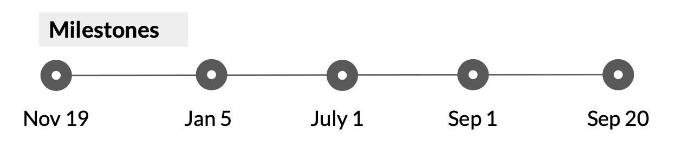
Timeline
Nov | Dec | Jan | Feb | Mar | Apr | May | Jun | Jul | Aug | Sep
Initiation
Planning
Implementation - Phase 1
Implementation - Phase 2
Monitoring
Closing
Notes:
Nov 19 milestone: SMT approval
Jan 5 milestone: Launch beta prototype
July 1 milestone: Full system deployment
Sep 1 milestone: Full review of first quarter system reports; identify success and areas of optimization
Sep 20 milestone: Post-mortem analysis & suggestions for v2.0

Slide 10
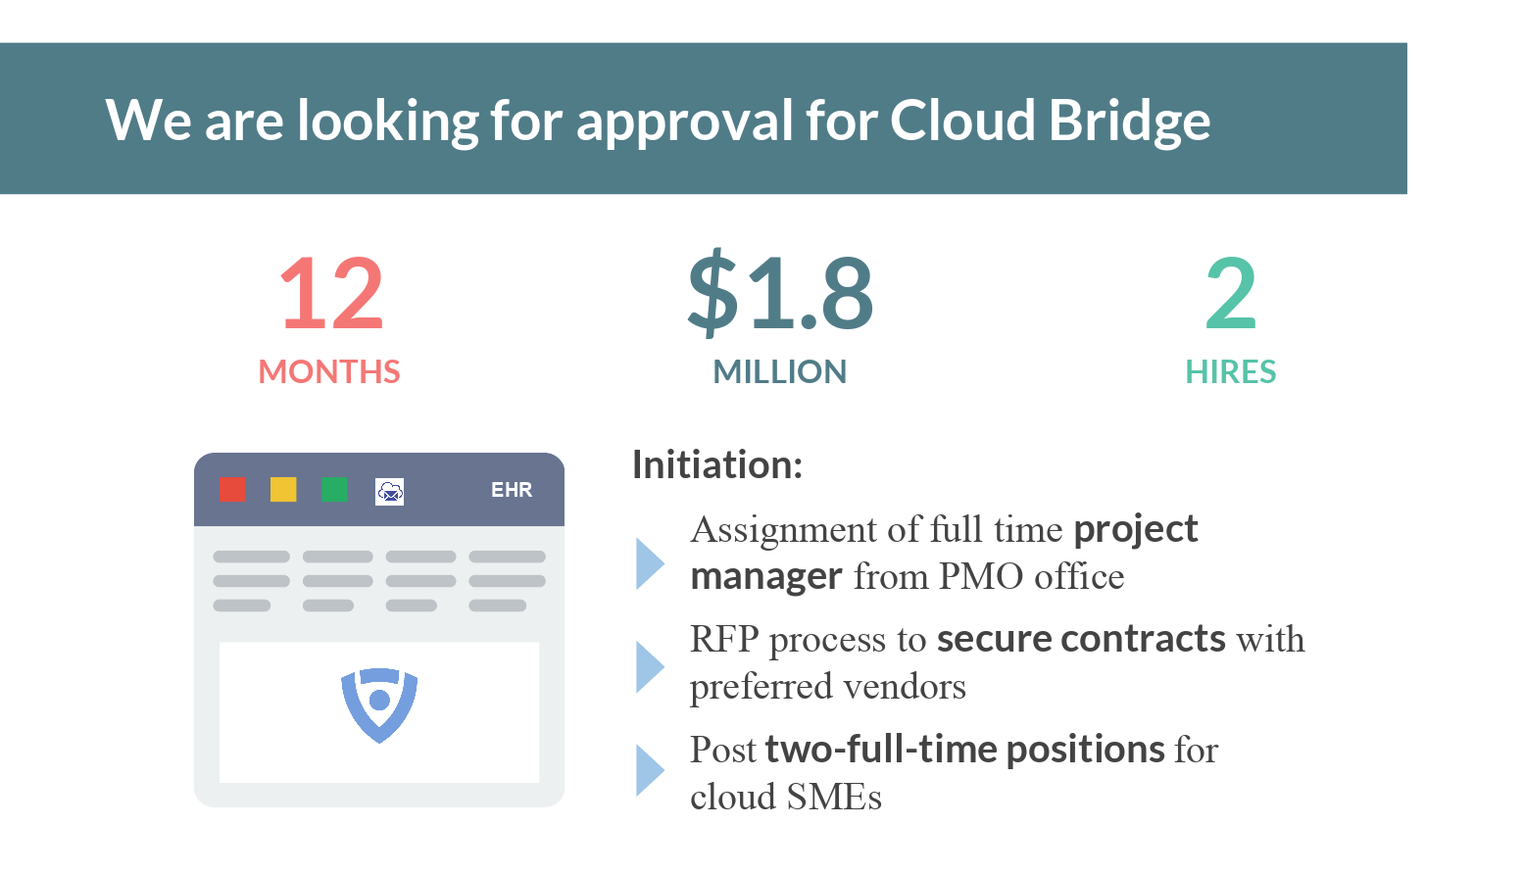
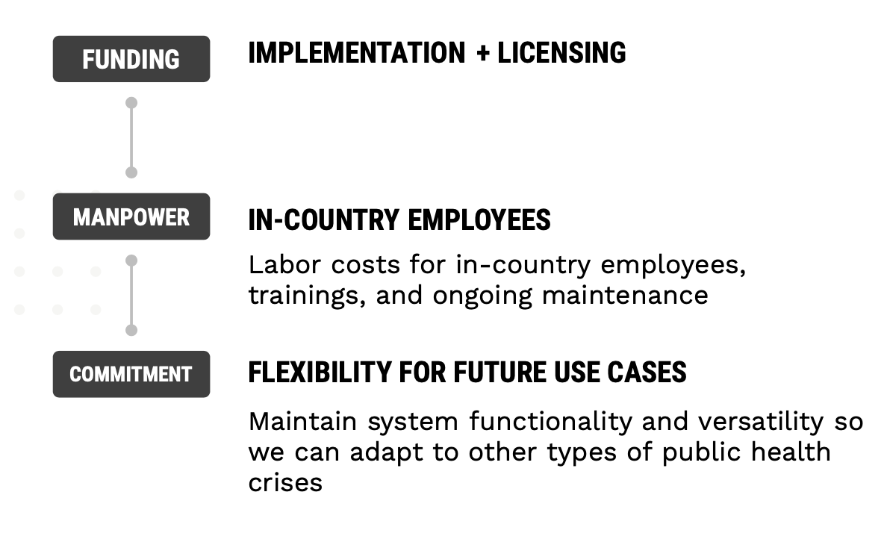
The Ask
CrisisCare Project Approval
2
local hires
One-time implementation cost for year 1
Licensing fee for subsequent years
11
months
$430K
total costs

Slide 11
Thank you
Questions?

